Slide 1
NFT marketplace:
Bored Ape Yacht Club study
Yifeng Wang yw3933
Yuxuan Zhao yz4397
Donglin Gu dg3294
Shifeng Zhang sz3104
Gehui Liang gl2800

Slide 2
Project Goal
In this project study, we aim to explore the NFT marketplace, with a particular focus on the Bored Ape Yacht Club (BAYC) collection. The BAYC is a popular NFT collection of 10,000 unique digital apes, which have become highly sought after by collectors and investors. Our study will examine the 2000 random BAYC collection and its impact on the NFT marketplace, as well as the broader trends in the NFT market.

Slide 3
Approaches
Literature Review (IPFS, OpenSea, NFT Port API Documentation)
Data Collection, Data Preprocessing
Data Exploration
Data Modeling
Future Prediction

Slide 4
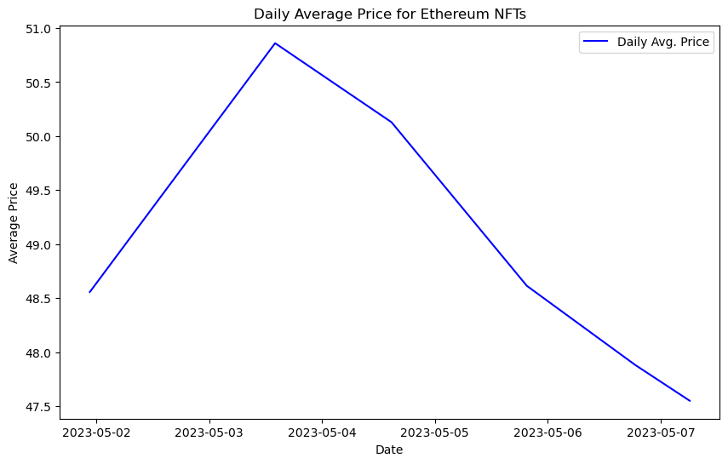
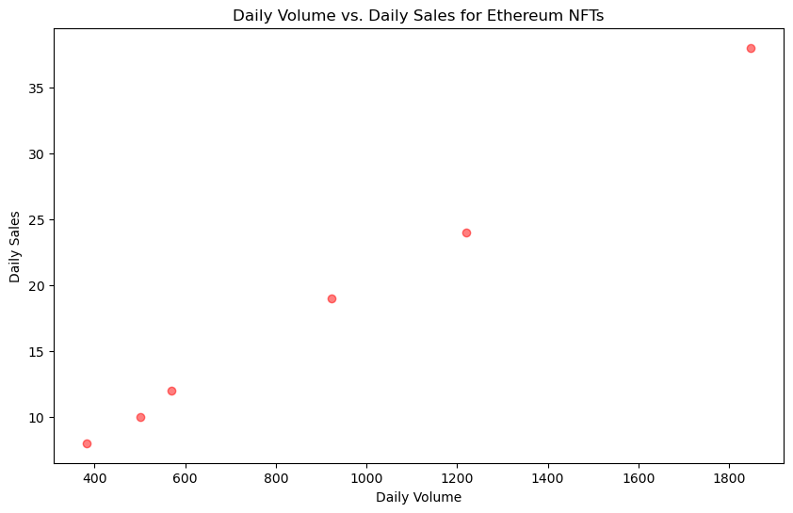
Insights and Market Trends in BAYC
Fluctuations in daily average price indicate market volatility
Positive correlation between daily volume and daily sales suggests strong demand and market growth

Slide 5
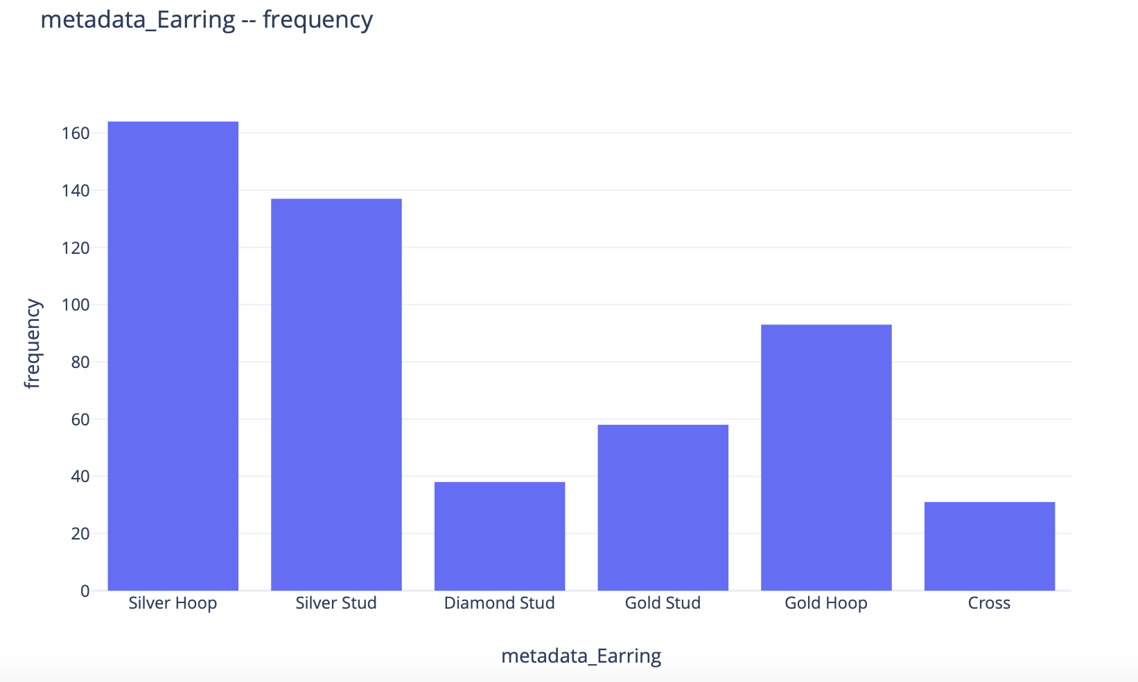
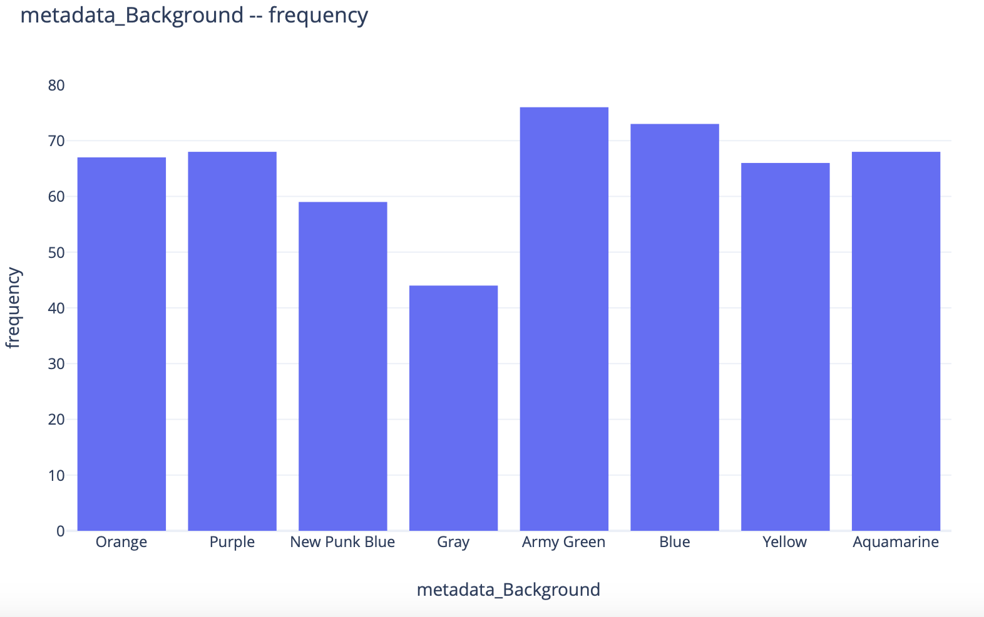
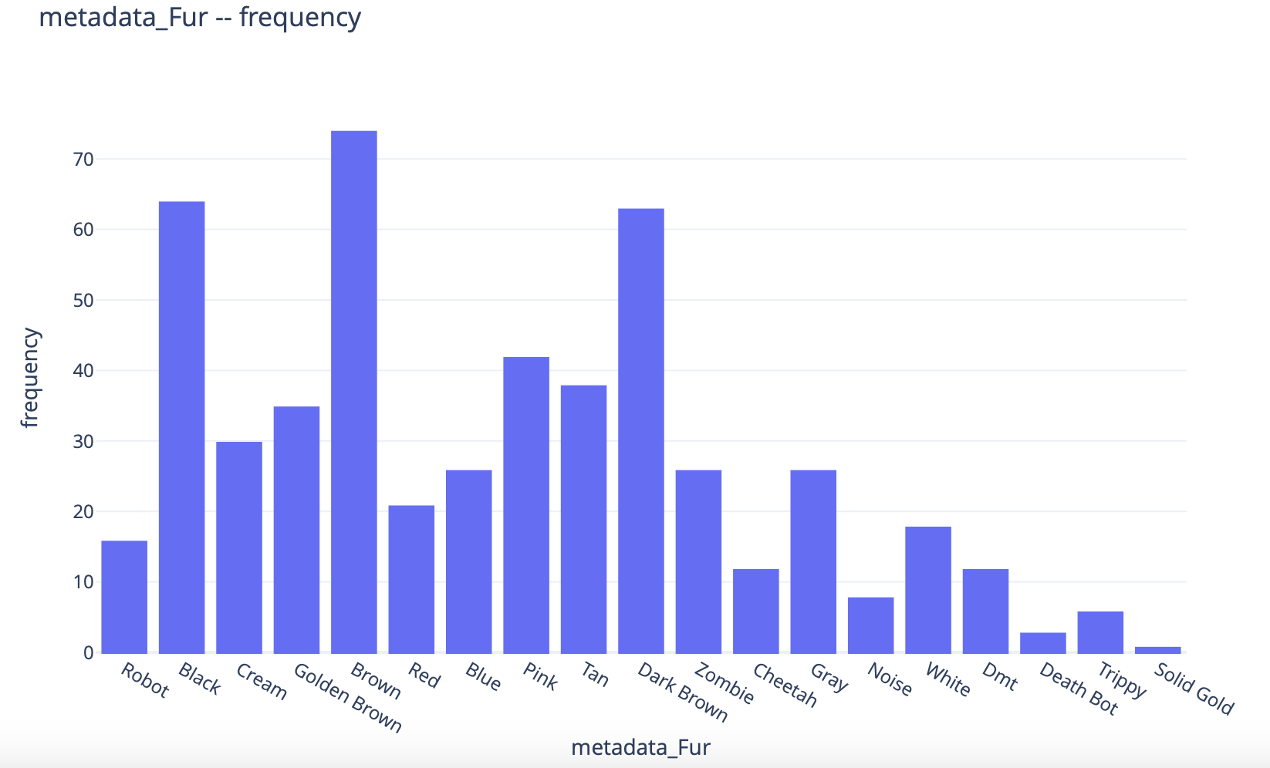
Key Players of Attributes in BAYC Collection
Grey is the least popular background in the market.
Silver Hoop and Silver Stud are the most popular two earrings in the market, and Diamond Stud is the least popular clothes in the market.
Brown, Black and Dark Brown are top 3 popular color for fur in the market, and solid gold is the least popular clothes in the market

Slide 6
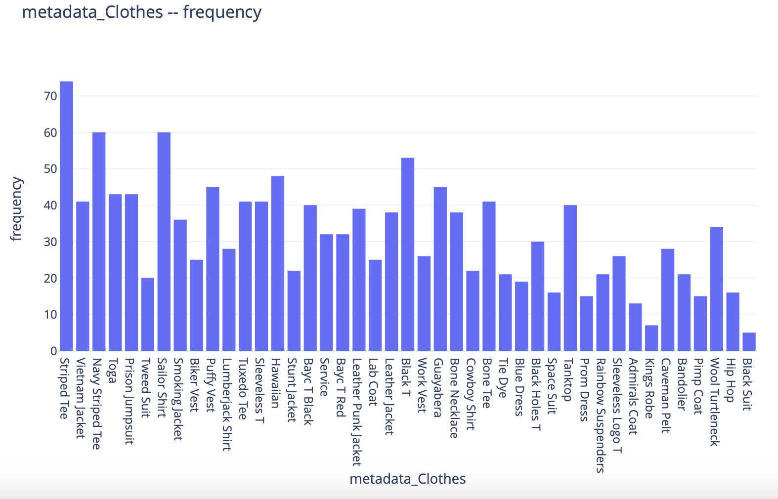
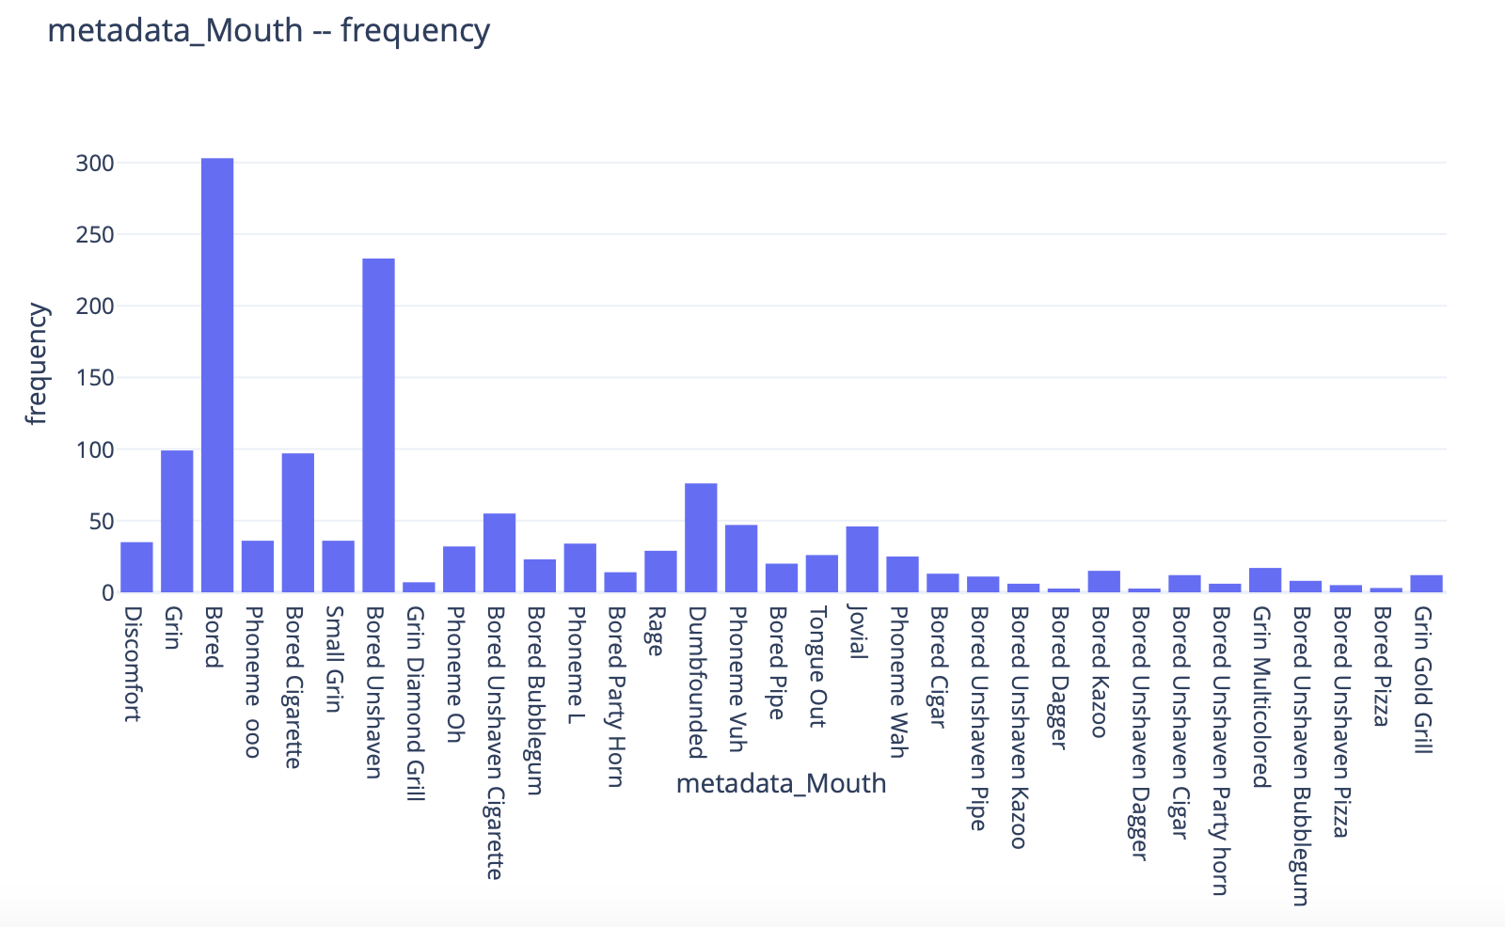
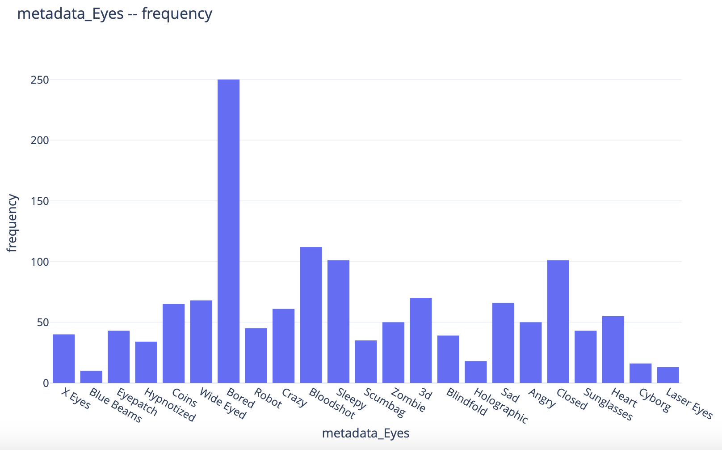
Key Players of Attributes in BAYC Collection
Striped lee is the most popular clothes in the market, and Black suit is the least popular clothes in the market.
Bored and Bored Unshaven are the most popular Mouths in the market.
Bored eyes are the most popular eyes in the market.

Slide 7
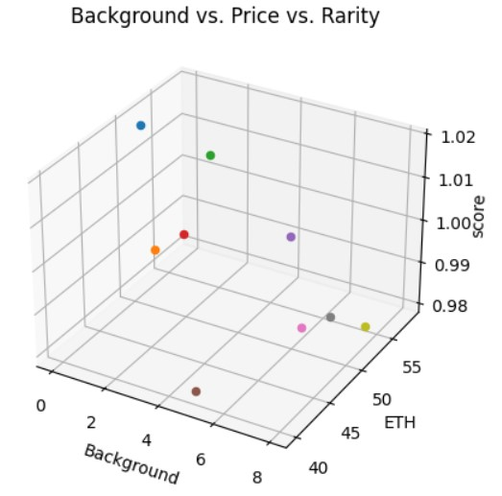
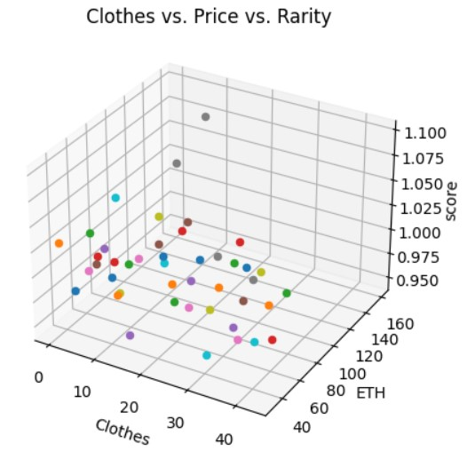
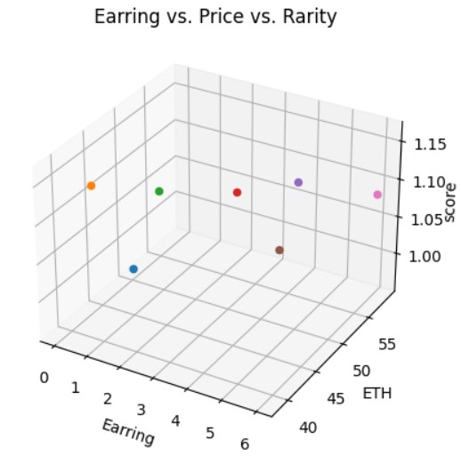
Scores vs. Price
Background: The score of background is concentrated around 1.0, while The sales prices are mostly distributed in the range of 50-60 ETH.
Clothes: The six most expensive NFTs in the Clothes category all have a rarity score of above 1.0.
Earring: The score of highest price for Earring group is concentrated around 1.1.

Slide 8
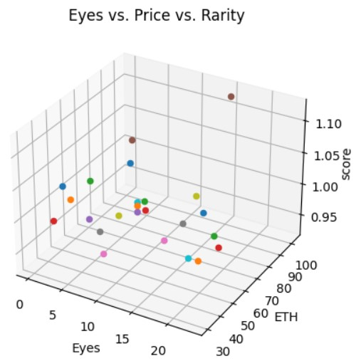
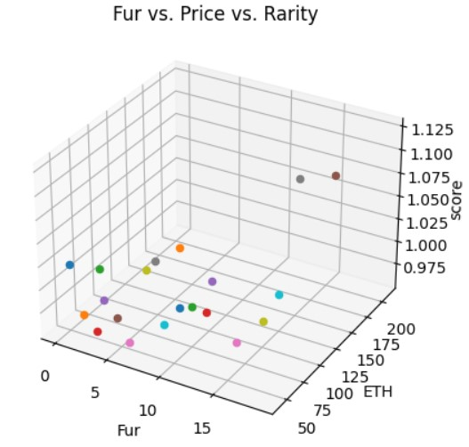
Scores vs. Price
Eyes: ‘Laser Eyes’ has the highest price in the market, and its rarity score is around 1.10.
Fur: Figure 12 shows that 'Solid Gold' and 'Trippy' have exceptionally high selling prices, with a score of 1.15 and 1.2, respectively.

Slide 9
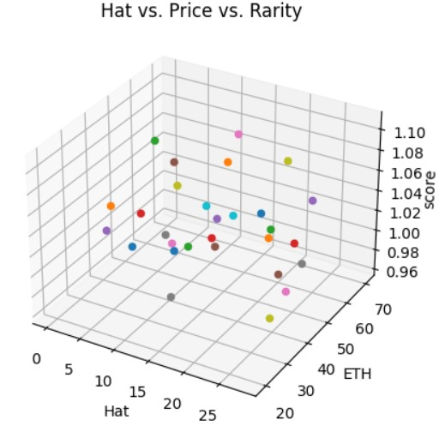
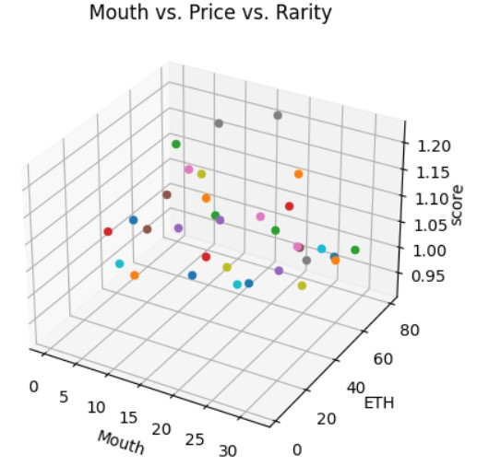
Scores vs. Price
Hat: 'Party Hat 2' has the highest prices, with a score of 1.06.
Mouth: 'Bored Party Horn' and 'Bored Unshaven Pizza' have the highest prices, with a score of 1.15 and 1.2, respectively.

Slide 10
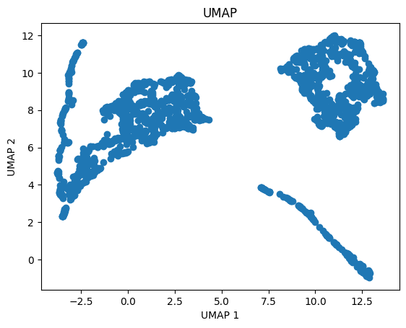
Clustering
Clustering Analysis
Uniform Manifold Approximation and Projection is a dimensionality reduction technique used for visualizing high-dimensional data in lower dimensions.
Records about the collection can be separated into three clusters from a higher dimension.
Meaning there are higher dimensional separations between the data points, at the same time, there are similarities within the cluster.

Slide 11
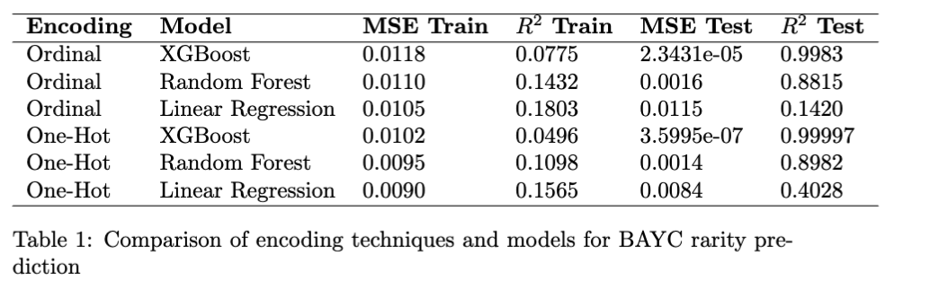
Machine Learning
Aims to find the trends of rarity and price of BAYC NFTs, two encoding tech-
niques were applied for the categorical variables: one-hot encoding and ordinal
encoding; and three machine learning models were used for the prediction tasks:
XGBoost, Random Forest, and Linear Regression.

Slide 12
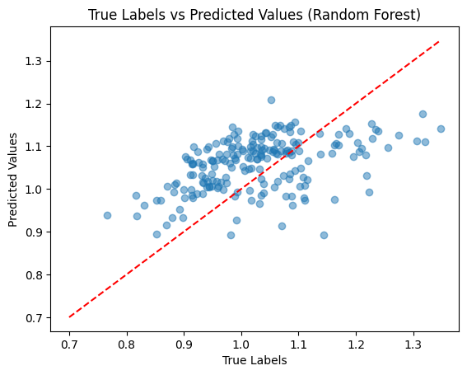
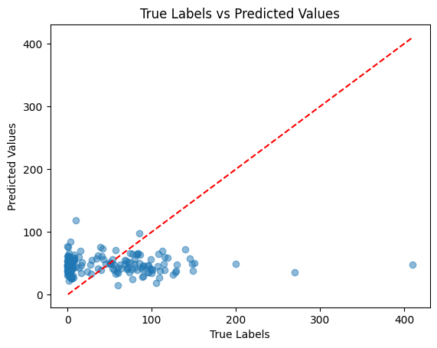
Machine Learning
Due to the imbalance of the NFTs’ prices, prediction of price does not show a trend.
To better build the models in the future, we need to retrieve more data hopefully from OpenSea API and
maybe we can use a time series model to make predictions of the trends of
prices and rarity scores of BAYC collection.

